Slide 1
Machine-learning prediction of terpene biosynthesis
Student: Roman Bushuiev
Supervisor: Dr. Tomáš Pluskal

Slide 2
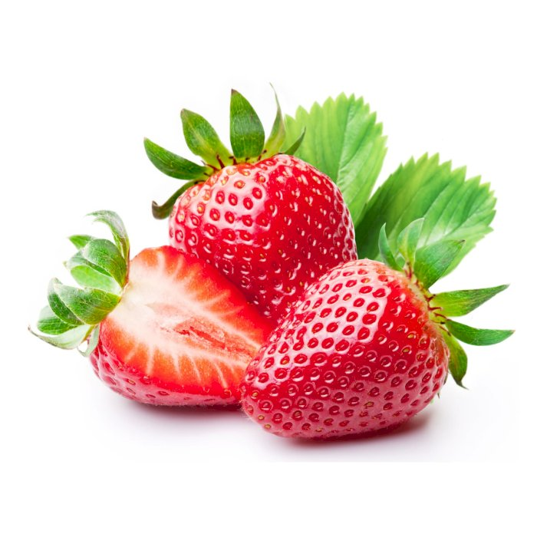
Biochemistry essentials: Small molecules

Slide 3
Biochemistry essentials: Small molecules
Aroma
Color
Sweetness

Slide 4
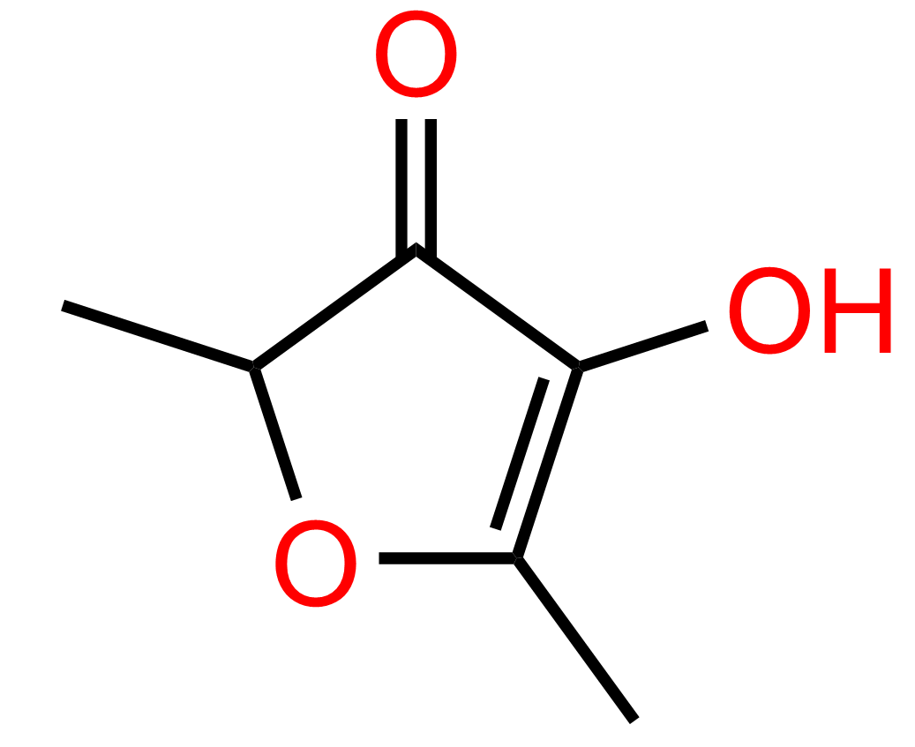
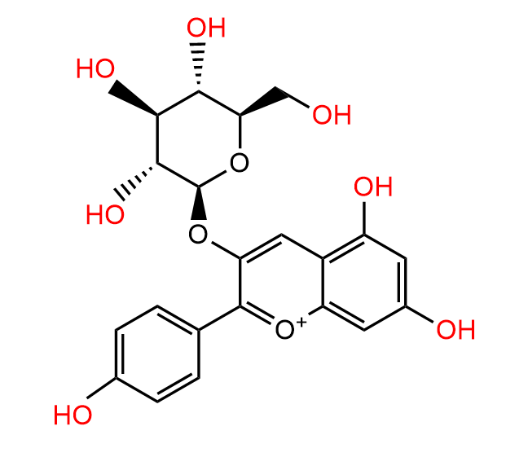
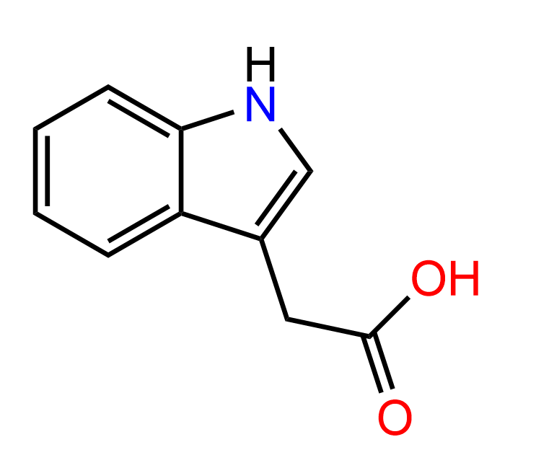
Biochemistry essentials: Small molecules
Aroma
Furaneol
Color
Pelargonidin 3-glucoside
Sweetness
Indole-3-acetic acid

Slide 5
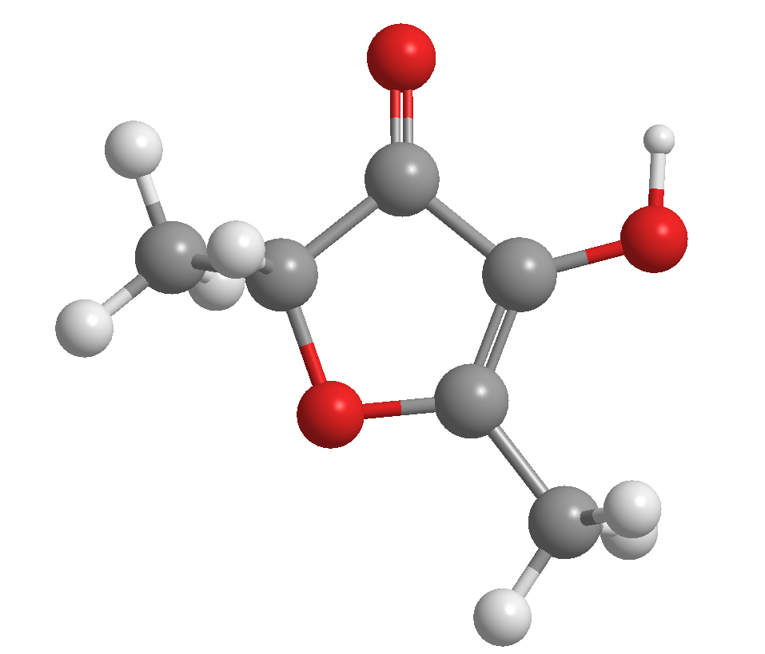
Biochemistry essentials: Small molecules representations
1.
2.

Slide 6
Biochemistry essentials: Small molecules representations
Nodes (atoms) labels:
O
C
H
Edges (bonds) labels:
2
1
1.
2.

Slide 7
Biochemistry essentials: Small molecules representations
Nodes (atoms) labels:
O
C
H
Edges (bonds) labels:
2
1
1.
2.
3.
SMILES string: CC1OC(C)=C(O)C1=O

Slide 8
Biochemistry essentials: Small molecules representations
Nodes (atoms) labels:
O
C
H
Edges (bonds) labels:
2
1
1.
2.
3.
SMILES string: CC1OC(C)=C(O)C1=O
4.
Chemical formula: C₆H₈O₃

Slide 9
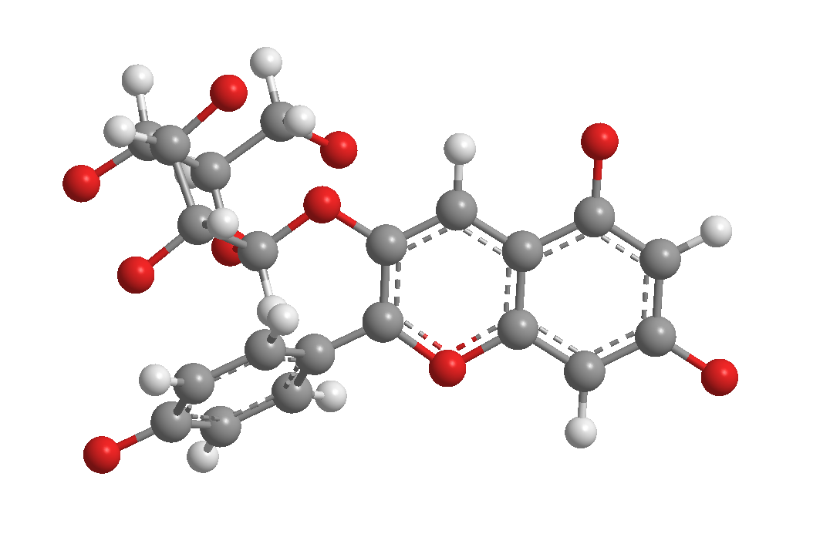
Biochemistry essentials: Small molecules representations
1.
2.
Bond is extending above the plane
Bond is extending behind the plane
3.
SMILES string: C1=CC(=CC=C1C2=[O+]C3=CC(=CC(=C3C=C2O[C@H]4[C@@H]([C@H]([C@@H]([C@H](O4)CO)O)O)O)O)O)O
4.
Chemical formula: C₂₁H₂₁O₁₀⁺

Slide 10
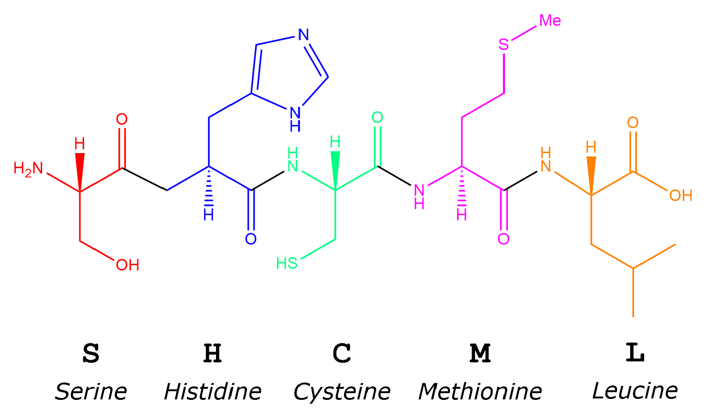
Biochemistry essentials: Proteins – the building blocks of life
Hundreds of amino acids long
…
…
20 possible amino acids

Slide 11
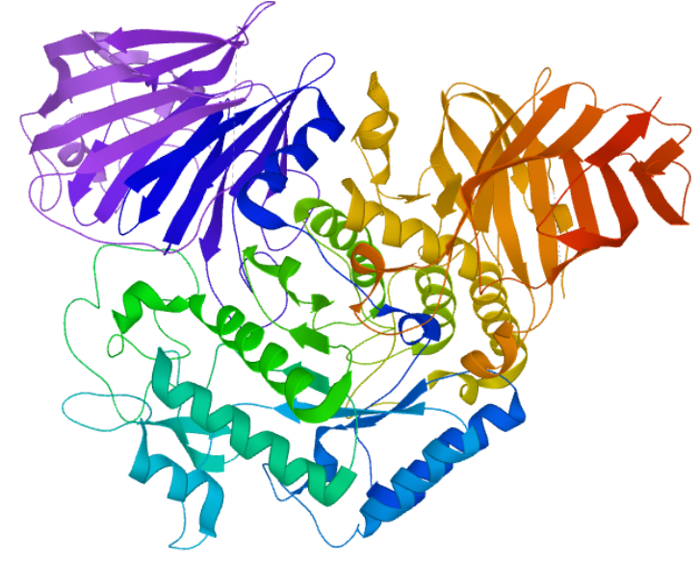
Biochemistry essentials: Protein representations
MGVRHPPCSHRLLAVCALVSLATAALLGHILLHDFLLVPRELSGSSPVLEETHPAHQQGA
SRPGPRDAQAHPGRPRAVPTQCDVPPNSRFDCAPDKAITQEQCEARGCCYIPAKQGLQGA
QMGQPWCFFPPSYPSYKLENLSSSEMGYTATLTRTTPTFFPKDILTLRLDVMMETENRLH
FTIKDPANRRYEVPLETPHVHSRAPSPLYSVEFSEEPFGVIVRRQLDGRVLLNTTVAPLF
FADQFLQLSTSLPSQYITGLAEHLSPLMLSTSWTRITLWNRDLAPTPGANLYGSHPFYLA
LEDGGSAHGVFLLNSNAMDVVLQPSPALSWRSTGGILDVYIFLGPEPKSVVQQYLDVVGY
PFMPPYWGLGFHLCRWGYSSTAITRQVVENMTRAHFPLDVQWNDLDYMDSRRDFTFNKDG
FRDFPAMVQELHQGGRRYMMIVDPAISSSGPAGSYRPYDEGLRRGVFITNETGQPLIGKV
WPGSTAFPDFTNPTALAWWEDMVAEFHDQVPFDGMWIDMNEPSNFIRGSEDGCPNNELEN
PPYVPGVVGGTLQAATICASSHQFLSTHYNLHNLYGLTEAIASHRALVKARGTRPFVISR
STFAGHGRYAGHWTGDVWSSWEQLASSVPEILQFNLLGVPLVGADVCGFLGNTSEELCVR
WTQLGAFYPFMRNHNSLLSLPQEPYSFSEPAQQAMRKALTLRYALLPHLYTLFHQAHVAG
ETVARPLFLEFPKDSSTWTVDHQLLWGEALLITPVLQAGKAEVTGYFPLGTWYDLQTVPV
EALGSLPPPPAAPREPAIHSEGQWVTLPAPLDTINVHLRAGYIIPLQGPGLTTTESRQQP
MALAVALTKGGEARGELFWDDGESLEVLERGAYTQVIFLARNNTIVNELVRVTSEGAGLQ
LQKVTVLGVATAPQQVLSNGVPVSNFTYSPDTKVLDICVSLLMGEQFLVSWC
Lysosomal alpha-glucosidase
Computer representation

Slide 12
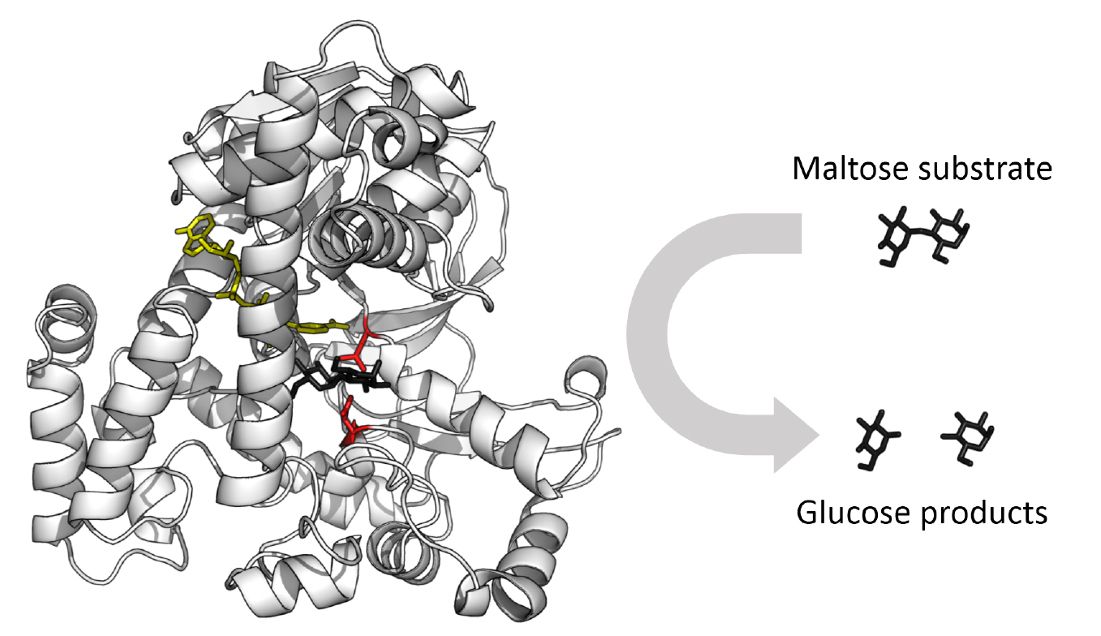
Biochemistry essentials: Enzymes – proteins catalyzing biosyntheses
Glucosidase

Slide 13
Comments? Questions?

Slide 14
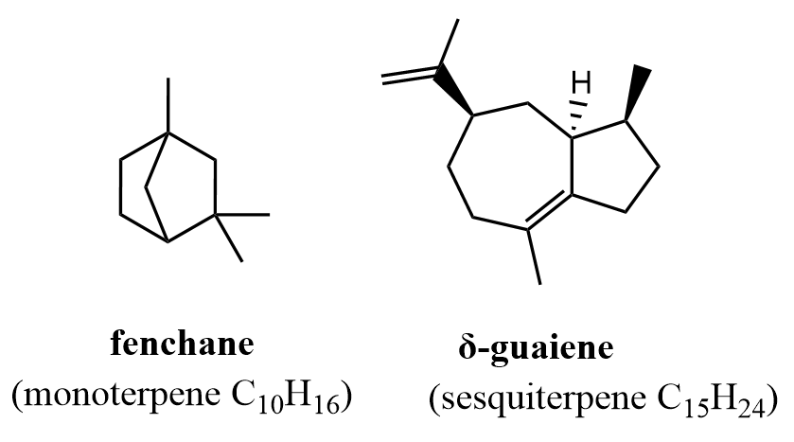
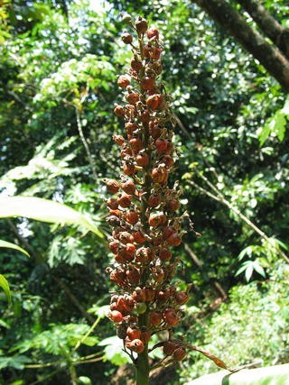
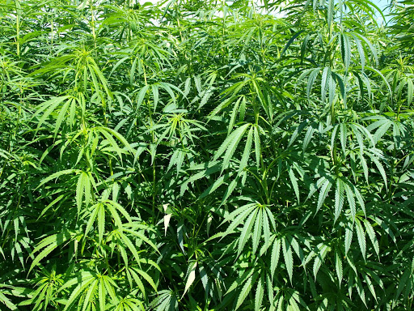
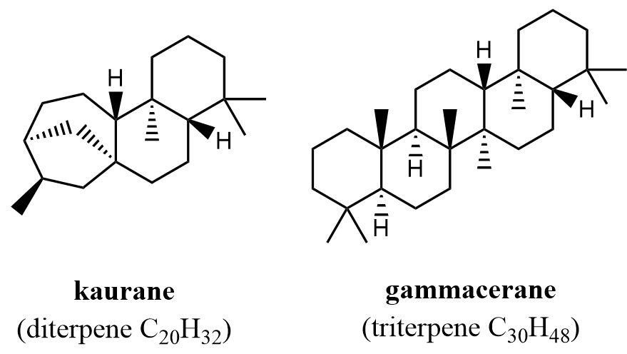
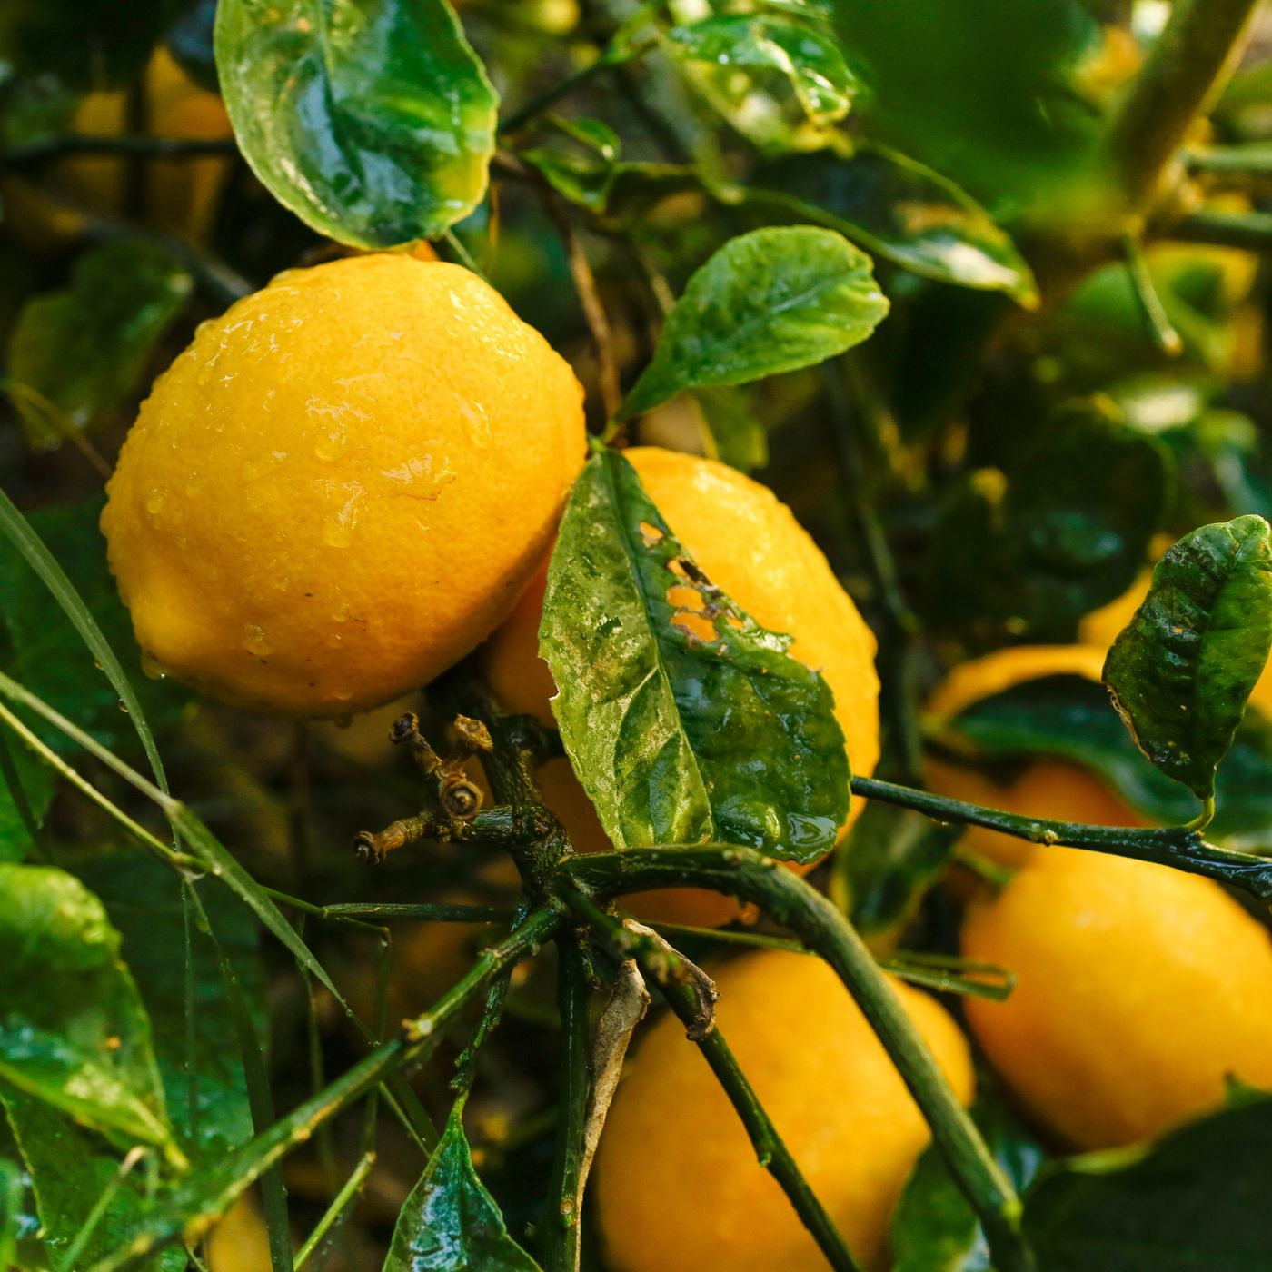
Terpenes - biggest class of plant specialized metabolites
Alpinia galanga
Cánnabis satíva
Citrus

Slide 15
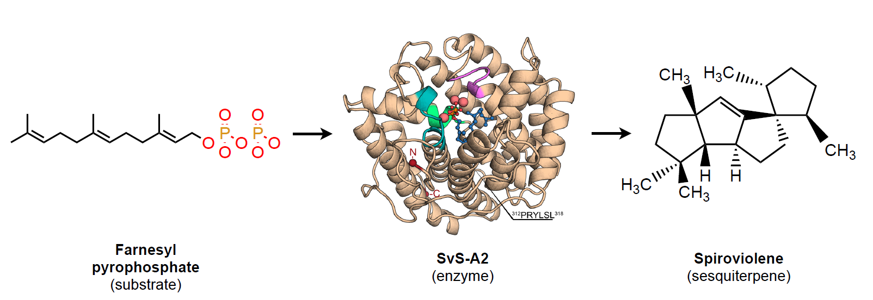
Terpene biosynthesis

Slide 16
Prediction of terpene biosynthesis
?

Slide 17
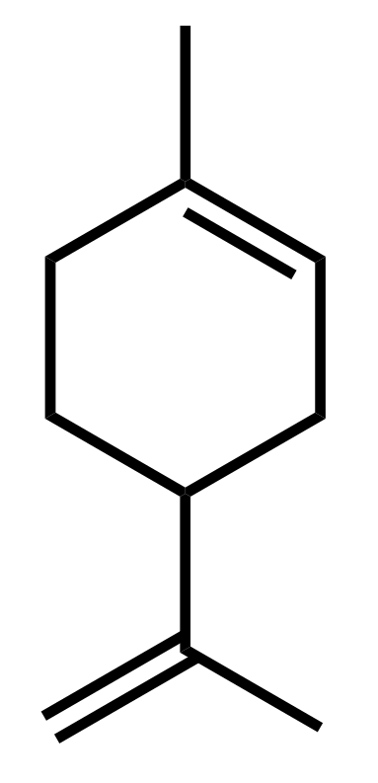
Motivation
About 25% of currently produced drugs are directly derived from plant specialized metabolites.
Prediction of biosyntheses has not been studied yet.
Anti-inflammatory, antioxidant, anticancer, and heart-disease-fighting properties
Limonene
(monoterpene)
Additive in foods, cosmetics, cleaning products, and natural insect repellants

Slide 18
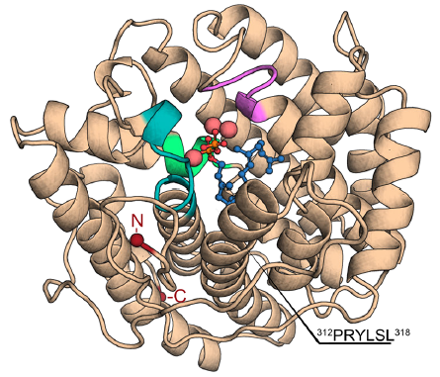
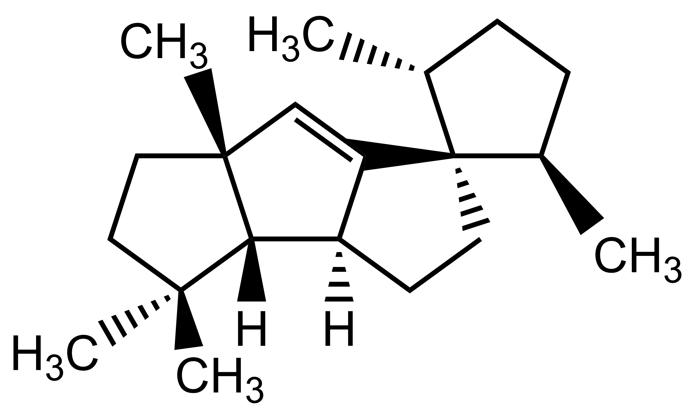
Terpene biosynthesis: computer representation
…SLSGVTWQIGNAAAGRMPGLDEYVAMRLLSAGGEPPFAMLELATGLEVPAQDLERPAVRALTEMAIMVAALDNDRHSLRKE…
C[C@@H]1CC[C@H](C12CC[C@@H]3C2=C[C@@]4([C@H]3C(CC4)(C)C)C)C
CC(=CCC/C(=C/CC/C(=C/COP(=O)(O)P(=O)(O)O)/C)/C)C
Input
Output

Slide 19
Terpene biosynthesis: computer representation
…SLSGVTWQIGNAAAGRMPGLDEYVAMRLLSAGGEPPFAMLELATGLEVPAQDLERPAVRALTEMAIMVAALDNDRHSLRKE…
C[C@@H]1CC[C@H](C12CC[C@@H]3C2=C[C@@]4([C@H]3C(CC4)(C)C)C)C
CC(=CCC/C(=C/CC/C(=C/COP(=O)(O)P(=O)(O)O)/C)/C)C
Input
Output
745 characterized reactions in total

Slide 20
Sesquiterpene biosynthesis
Sesquiterpene biosynthesis
1. Can be predicted with 0.95 precision
…SLSGVTWQIGNAAAGRMPGLDEYVAMRLLSAGGEPPFAMLELATGLEVPAQDLERPAVRALTEMAIMVAALDNDRHSLRKE…
C[C@@H]1CC[C@H](C12CC[C@@H]3C2=C[C@@]4([C@H]3C(CC4)(C)C)C)C
CC(=CCC/C(=C/CC/C(=C/COP(=O)(O)P(=O)(O)O)/C)/C)C
Input
Output
2. 404 of 745 reactions are biosyntheses of sesquiterpenes

Slide 21
Sesquiterpene biosynthesis
…SLSGVTWQIGNAAAGRMPGLDEYVAMRLLSAGGEPPFAMLELATGLEVPAQDLERPAVRALTEMAIMVAALDNDRHSLRKE…
C[C@@H]1CC[C@H](C12CC[C@@H]3C2=C[C@@]4([C@H]3C(CC4)(C)C)C)C
Input
Output
398 characterized reactions in total

Slide 22
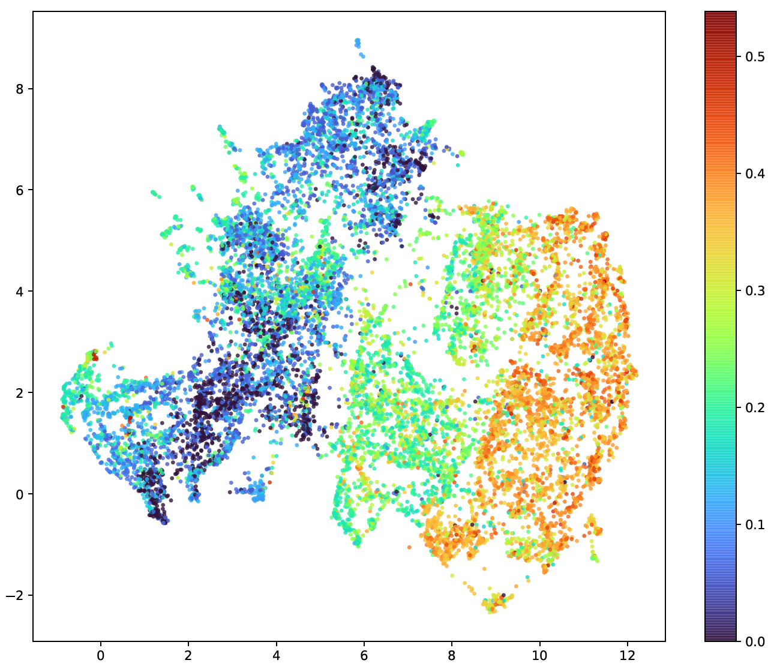
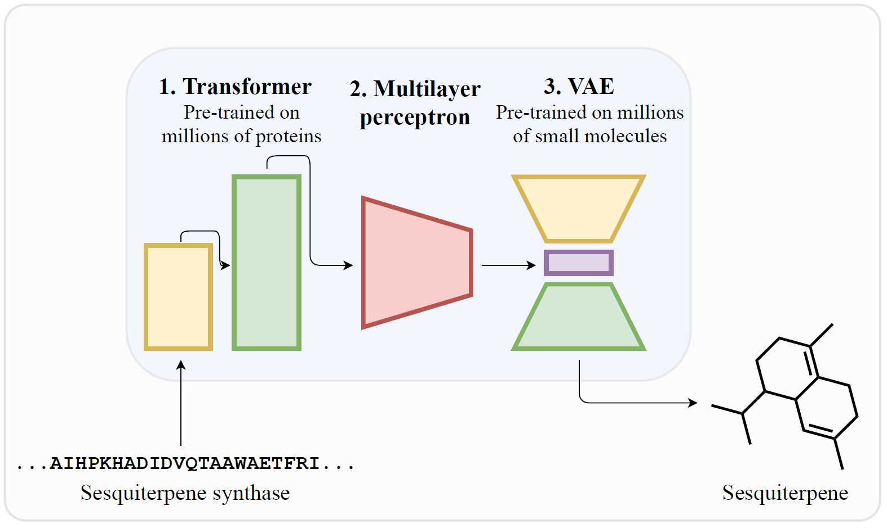
Proposed solution
Each dot represents a molecule
(Color: fraction of double bonds with respect to all bonds)

Slide 23
Main steps:
Data preparation
Evaluation metric selection
Transformer (1.)
Variational autoencoder (3.)
Multilayer perceptron (2.)
Results

Slide 24
Data preparation: TPS database
Enzyme sequence
SMILES of product
Substrate
Type
…
…
sesq
13 features
((2E,6E)-FPP
…PLFSPIRQAIHP…
…[C@@](CCC[C@@H]1…
…
745 samples = 86 + 66 + 8 * 66 + 65
(398/745 correspond to sesquiterpene biosyntheses)
Hidden test fold
Test fold
Train folds (9-Fold Cross-Validation)

Slide 25
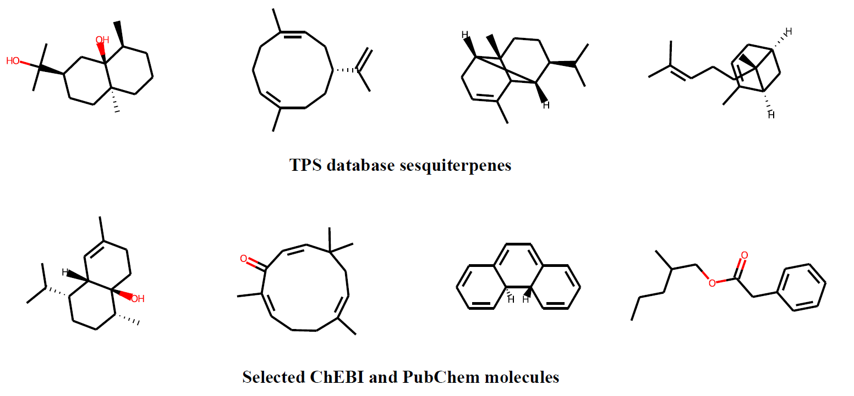
Data preparation: SesqSim dataset
16,311 molecules (either sesquiterpenes or molecules similar to sesquiterpenes)
Similarity based on the ChEBI ontology
Similarity based on the structure

Slide 26
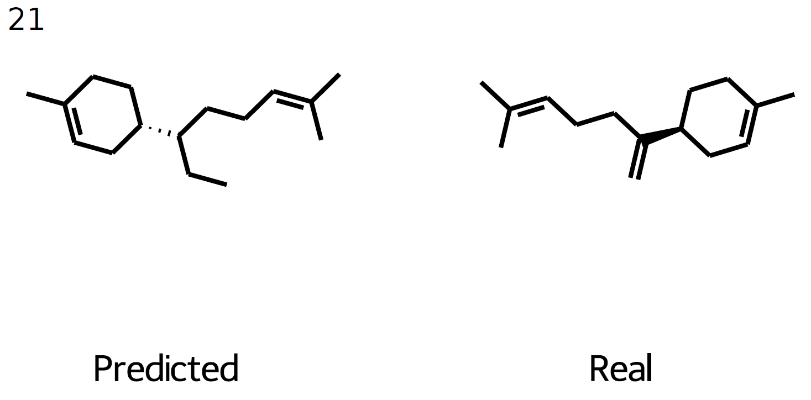
Evaluation metric
?
=

Slide 27
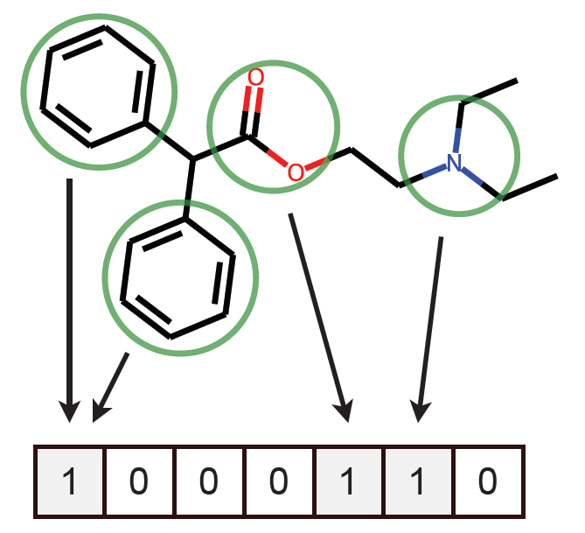
Evaluation metric selection: Molecular fingerprints

Slide 28
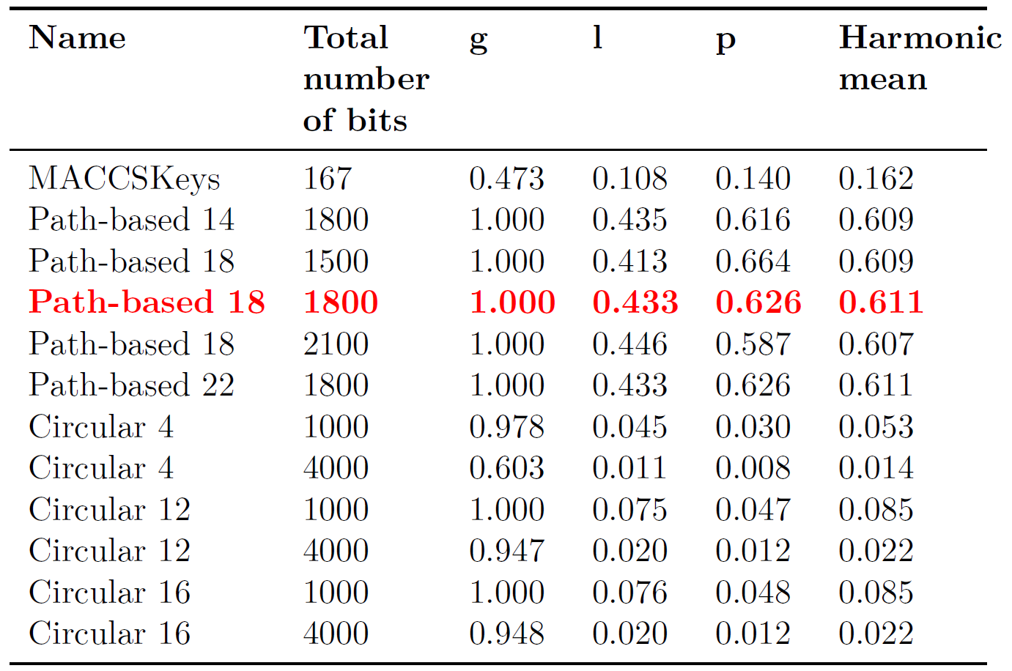
Evaluation metric selection: Fingerprint selection
410 sesquiterpenes from TPS database + 410 molecules from SesqSim:
g - fraction of different bits within all fingerprints
l - mean fraction of different bits between all pairs of TPS database sesquiterpenes and selected SesqSim molecules
p - mean fraction of positive bits within all fingerprints

Slide 29
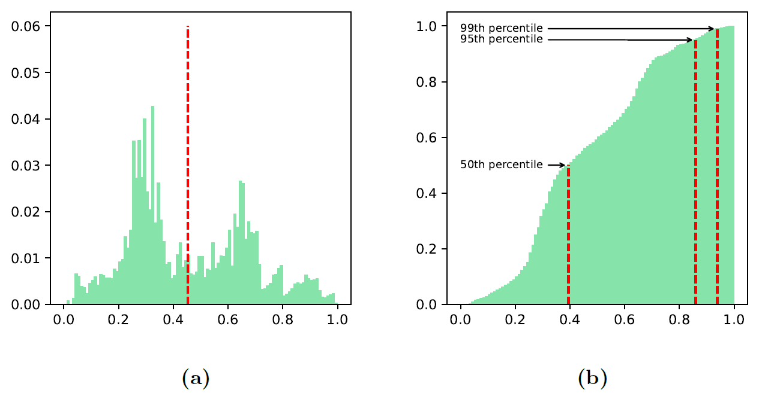
Evaluation metric selection: Metric on fingerprints
(Intersection over union on positive bits)

Slide 30
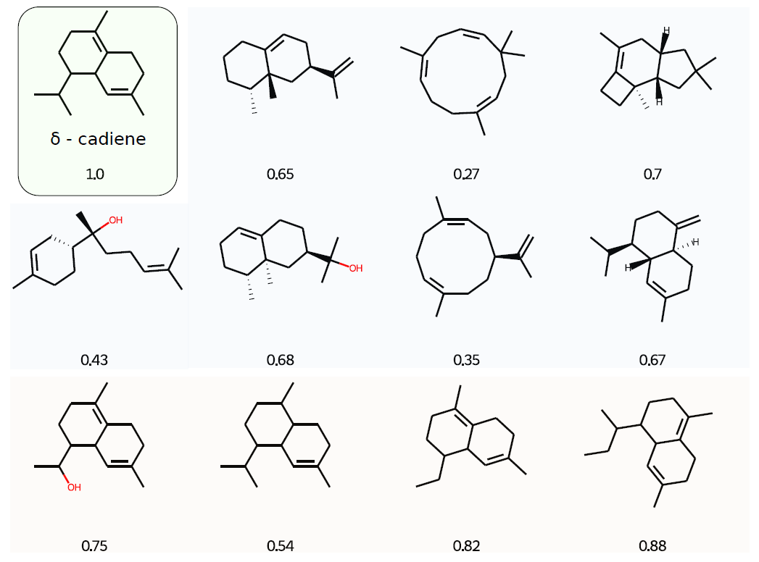
Evaluation metric selection: Examples

Slide 31
ESM-1b Transformer (1.)
[Rives et al.]

Slide 32
…KAAGFGYSMDTRRVIRY…
ESM-1b Transformer (1.)
Trained on masked language modeling task on 86 billion amino acids across 250 million protein sequences spanning evolutionary diversity
Training
…KA?GFGYSM?TRRVIRY…

Slide 33
ESM-1b Transformer (1.)
Trained on masked language modeling task on 86 billion amino acids across 250 million protein sequences spanning evolutionary diversity
The model contains information about biological properties in its representations
The learned representation space has a multiscale organization reflecting structure from the level of biochemical properties of amino acids to remote homology of proteins

Slide 34
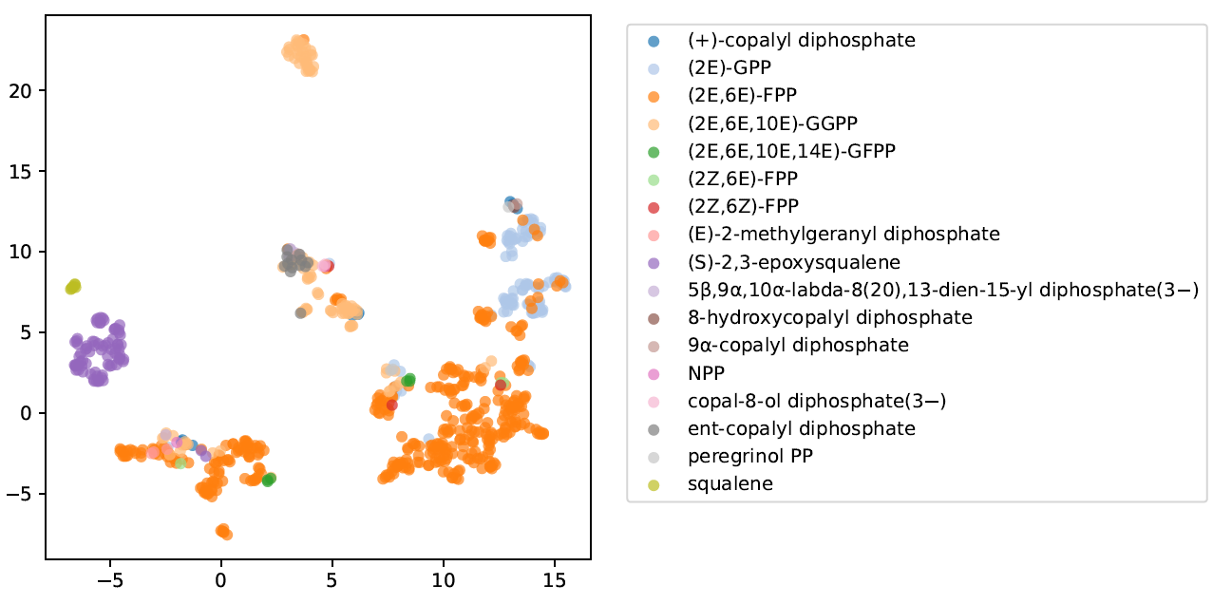
ESM-1b Transformer: UMAP on TPS database embeddings
Substrate:
Conclusion:
embeddings capture enzyme activity

Slide 35
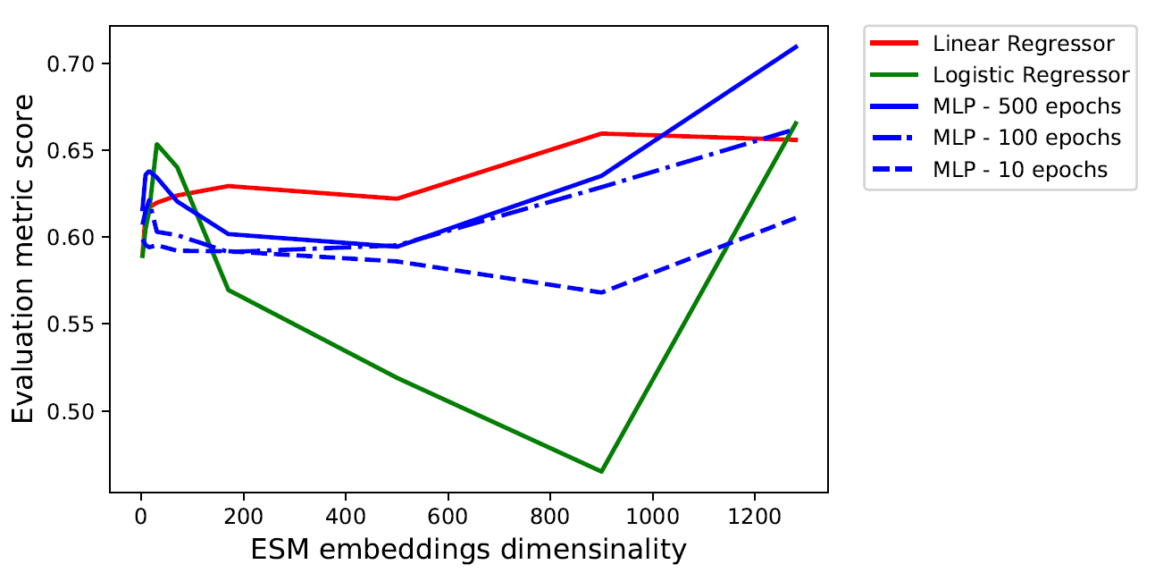
ESM-1b Transformer: Fingerprint prediction
Prediction of the molecular fingerprint
Conclusion:
ESM-1b Transformer is appropriate for the primary task

Slide 36
Chemical VAE (3.)
[Gómez-Bombarelli et al.]

Slide 37
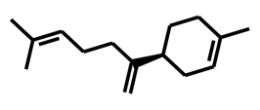
Chemical VAE (3.)
Variational autoencoder on SMILES strings:
Encoder: 1D convolution (3 layers)
Decoder: GRU (3 layers)
Trained on 250 000 synthetic molecules from ZINC database
Training

Slide 38
Chemical VAE (3.)
Variational autoencoder on SMILES strings:
Encoder: 1D convolution (3 layers)
Decoder: GRU (3 layers)
Trained on 250 000 synthetic molecules from ZINC database
Proved its efficiency in various generative tasks on small molecules (e.g. discovering new antibiotics)
Was fine-tuned on SesqSim dataset

Slide 39
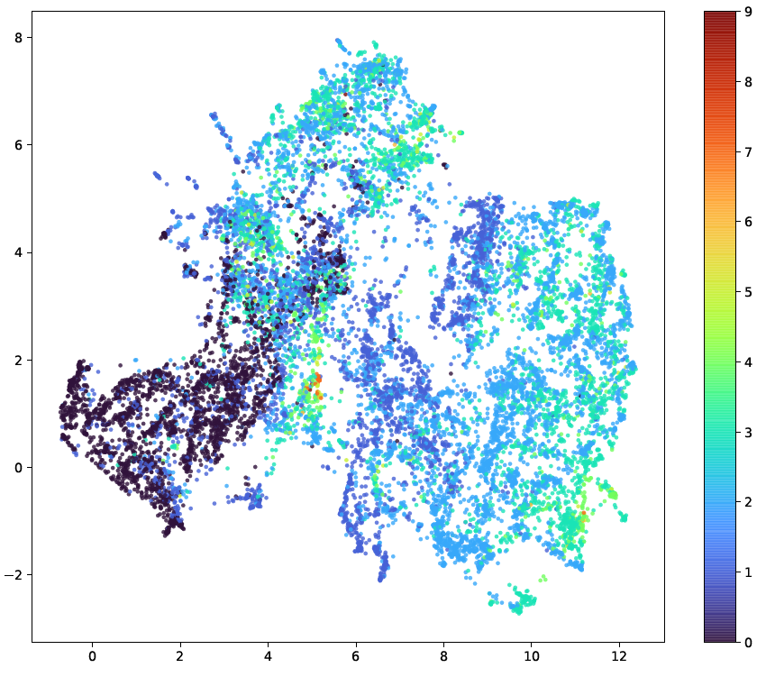
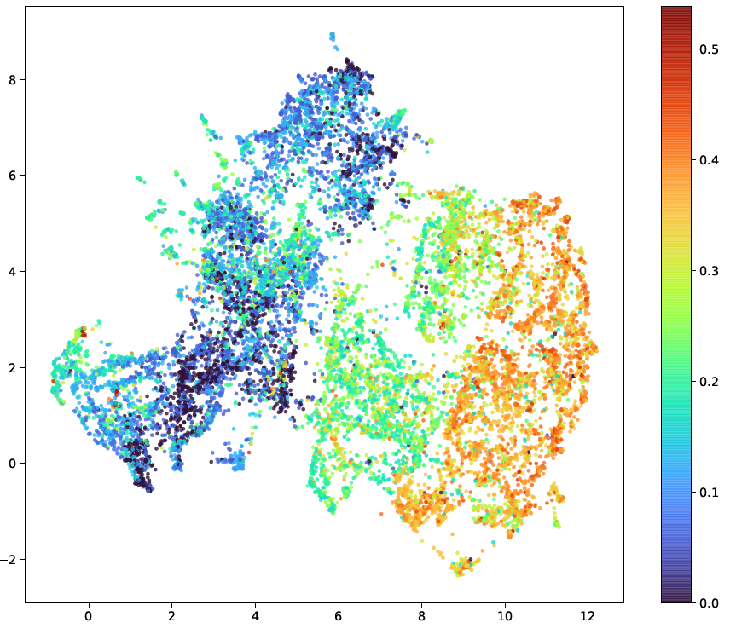
Fine-tuned Chemical VAE: UMAP on SesqSim encodings
Conclusion:
Embeddings capture molecular structure
Color: size of the smallest set of smallest rings
Color: fraction of double bonds with respect to all bonds
Each dot represents a molecule

Slide 40
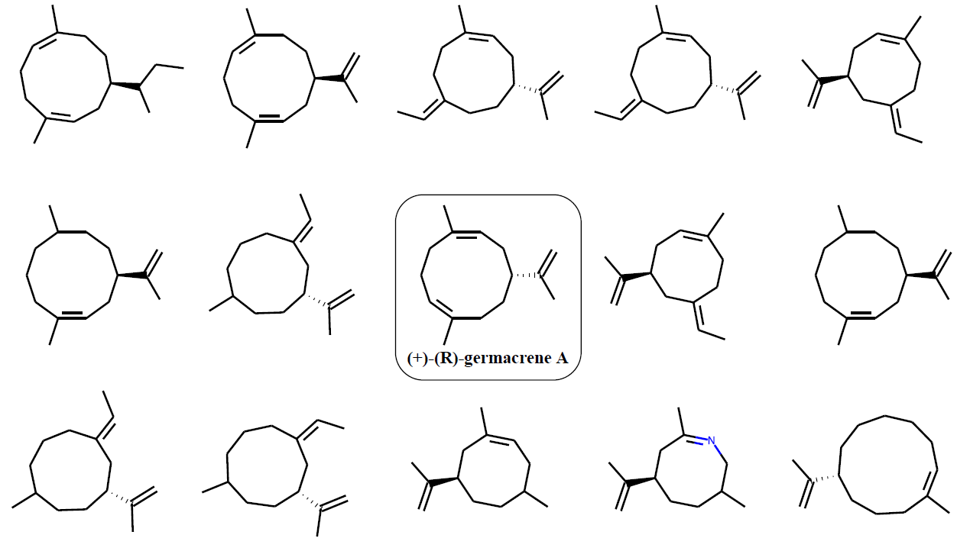
Fine-tuned Chemical VAE: neighborhood sampling
Conclusion:
Fine-tuned Chemical VAE is appropriate for the primary task

Slide 41
Multilayer perceptron (2.)
1280-dimensional input (enzyme) and 196-dimensional output (product)
Tested hyperparameters:
1 - 4 hidden layers
ReLU/sigmoid activation functions
10 – 3000 training epochs
Training:
9-Fold Cross-Validation on 315 TPS database samples
MSE loss function

Slide 42
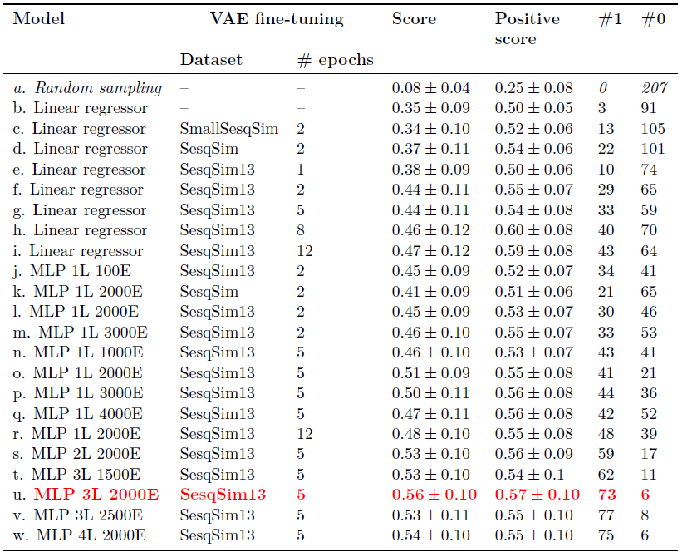
Validation scores
Score – mean evaluation metric score (IoU on fingerprints) for 9-Fold Cross-Validation
Positive score – same as score but considering only positive scores
#1 – number of perfect predictions (score == 1)
#0 – number of invalid predictions (score == 0)

Slide 43
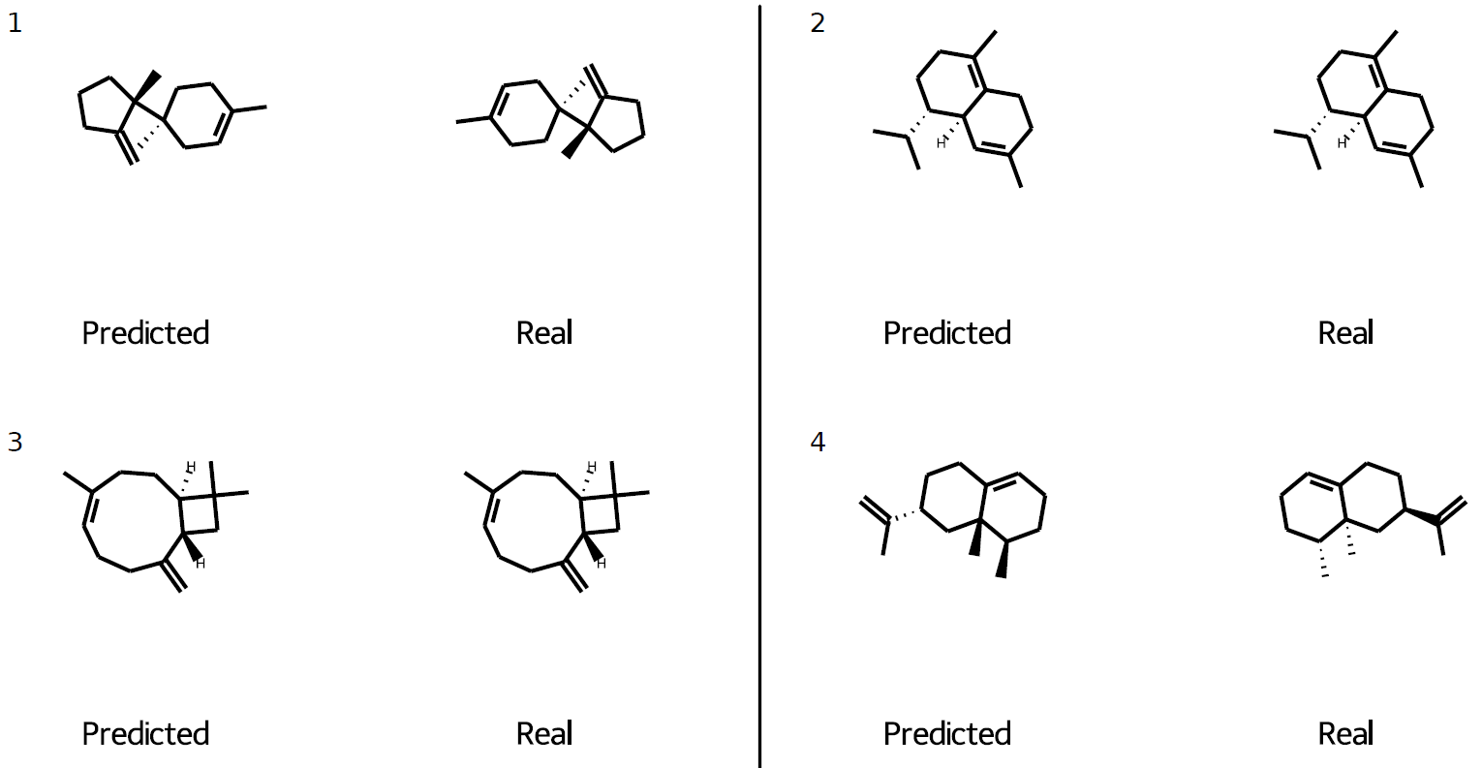
Test fold predictions 1: perfect predictions (11/34)

Slide 44
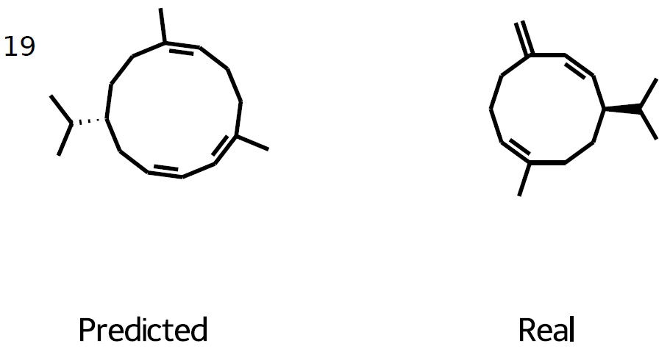
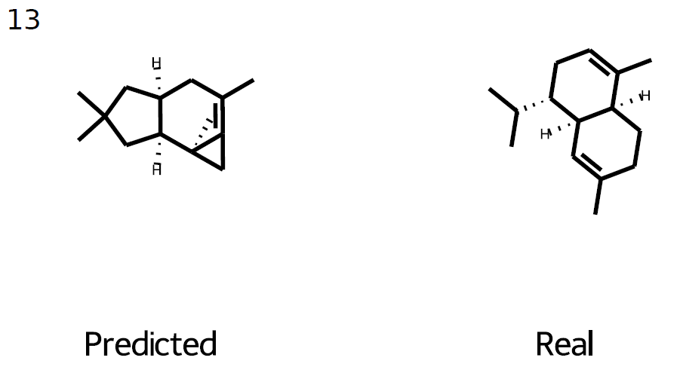
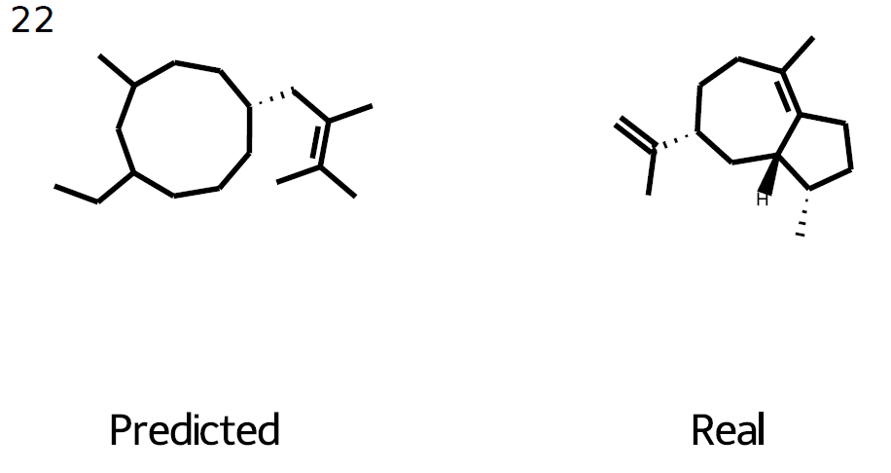
Test fold predictions 2: preserved structural features (14/34)

Slide 45
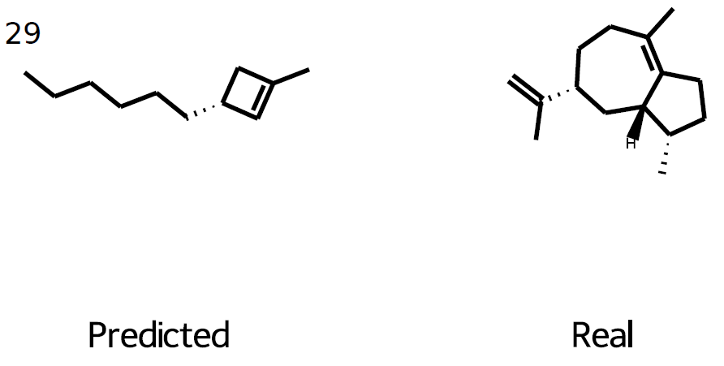
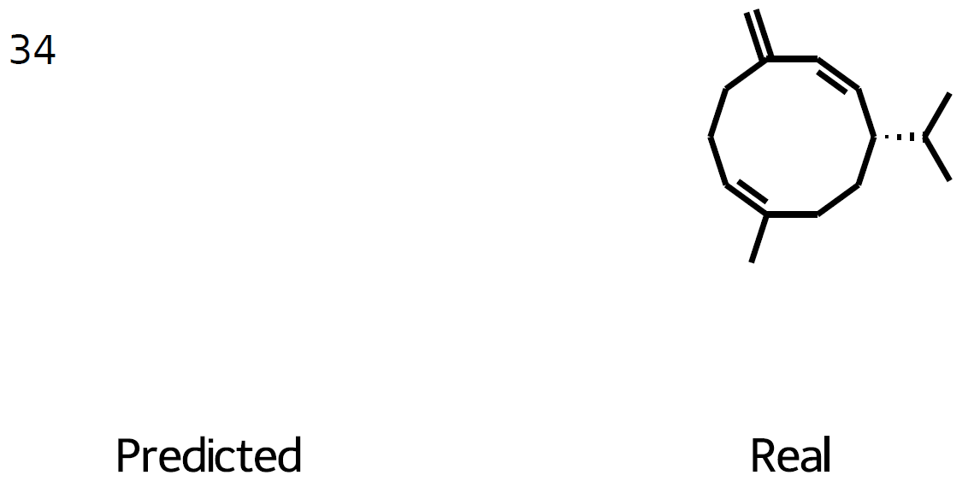
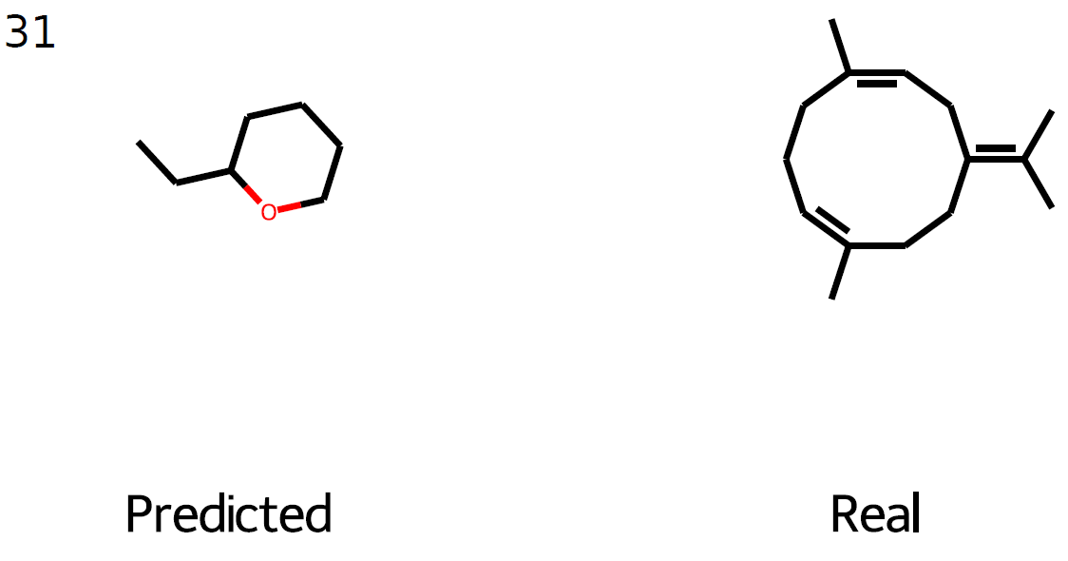
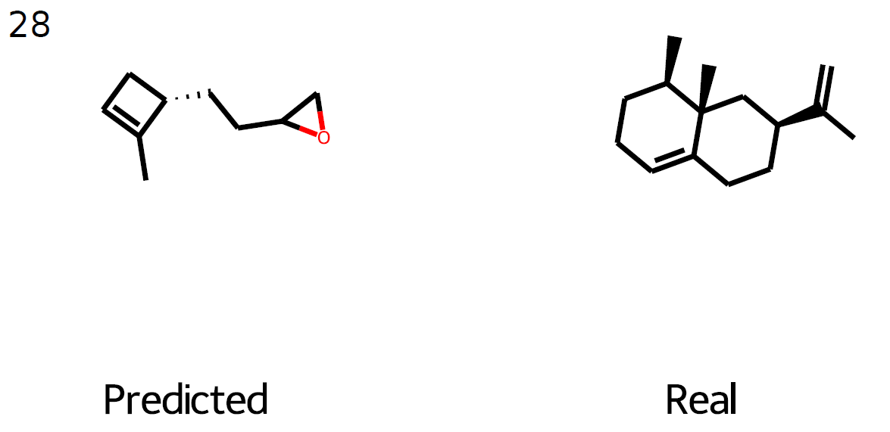
Test fold predictions 3: bad predictions (9/34)

Slide 46
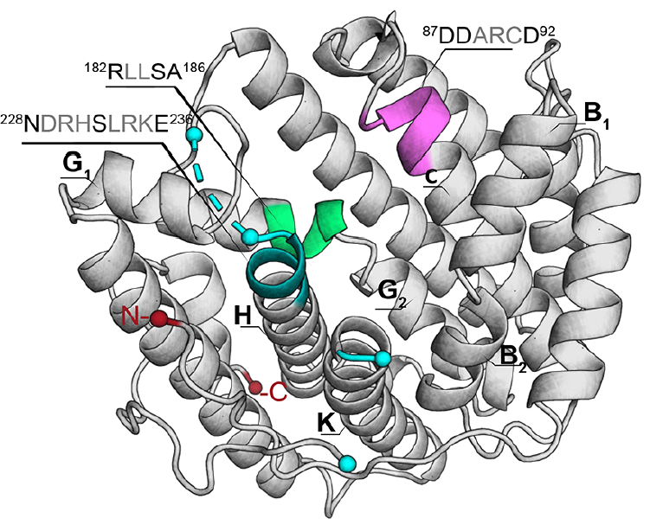
Application
?
Sesquiterpene synthase enzyme of interest
Unknown product

Slide 47
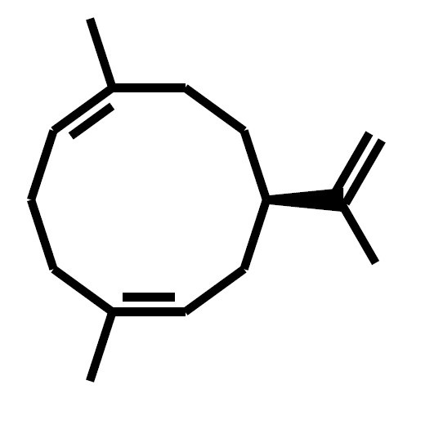
Application
Sesquiterpene synthase enzyme of interest
Predicted sesquiterpene

Slide 48
Application
Satisfies sesquiterpene formula (C₁₅H₂₄)?
Sesquiterpene synthase enzyme of interest
Predicted sesquiterpene

Slide 49
Application
High-confidence correct prediction
YES
Satisfies sesquiterpene formula (C₁₅H₂₄)?
Sesquiterpene synthase enzyme of interest
Predicted sesquiterpene

Slide 50
Application
High-confidence correct prediction
YES
Satisfies sesquiterpene formula (C₁₅H₂₄)?
Sesquiterpene synthase enzyme of interest
Predicted sesquiterpene
NO
???

Slide 51
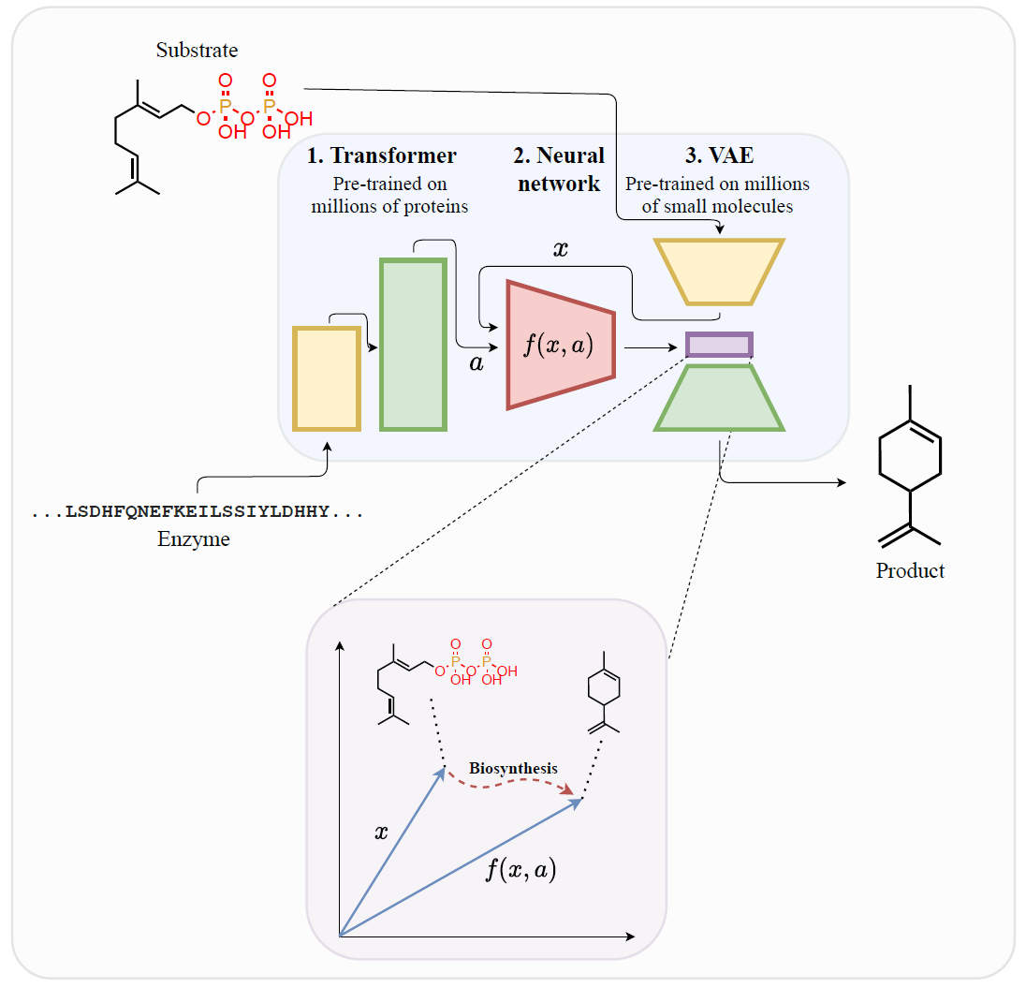
Future work
Generalization to any biosynthesis by encoding substrate to the latent space of VAE
Graph neural networks for small molecules
Dynamic(Temporal) graph neural networks to obtain embeddings of the complete biosynthetic reactions
Improved datasets

Slide 52
Contributions
New machine-learning approach for the essential biochemistry problem
Each fifth uncharacterized sesquiterpene biosynthesis can be predicted with a high confidence level
Promising basis for the future work

Slide 53
Thank you for attention!

